Slide 1

Life in a Sunless Sea Trevor, John, Isla, Mihir, Divit, Philip
Beyond Sunlight: An Aquatic Chemosynthetic World

Slide 2
Background
The task is to envisage what a world that only had chemosynthetic life would be like.
We decided that a board game would be a way for people to learn about chemosynthetic life AND generate many possible worlds.
In our thinking we have a planet covered in a thick icesheet with liquid water beneath. Thus, no light can penetrate to the sea floor where life must be chemosynthetic if it exists at all.
We have developed a board game, but it could be extended to symbiotic life and or life sustained by radioactive means

Slide 3
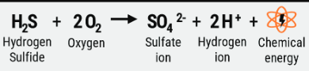
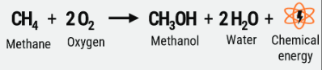
Science
We looked at how chemosynthetic life works on earth:
Thermal vents (Black smokers)
Cold Seeps (White smokers)
Chemistry – there are other combinations, but we stuck to theses ones
Conditions
Solvent
Chemicals
A key ingredient is consistent conditions.

Slide 4
The board game
Initial thoughts were for a happy families type card game, or maybe each player would play as individual planets trying to develop life before the others.
In the end we felt a game where all players played on the same planet would work best.
Aimed at 10 years +
A planet made up of hexagons which could be shuffled and laid out randomly to create a new world. Some hexs would be vents or seeps.
Players place the chemical compounds needed near the vents or seeps.
Life would develop on the intersection of 3 hexs where the two key compounds and the correct conditions existed.
We did ask ChatGPT and GeminiAI, but neither suggested anything better (or anything we liked)
We built a prototype and played it - AND it worked
We then refined our design.

Slide 5
Current design
63 Hexs make up the planet. Mostly barren hexs
There are a 6 vents and 6 seeps in the initial layout with spare vents and barren hexes in case of meteorite strike or volcanic action
Element cards – 8x carbon, 8x Sulphur, 22x Hydrogen molecules and 32x Oxygen molecules – (we decided on molecules as these seemed likely to be the form in real life and also so the game didn’t take too long gathering elemental H and 0)
Players take turns in Picking up 2 Element or action cards. If they can they create chemical compounds with elements they have in hand. Then:
Trade elements with other players.
Place compounds
Place life cards
Do actions like meteorite strike, climate change or volcanic action which change the conditions on various hexs so life develops or is destroyed.
Once a player gains 10 points the game ends and the exoplanet has been created.

Slide 6
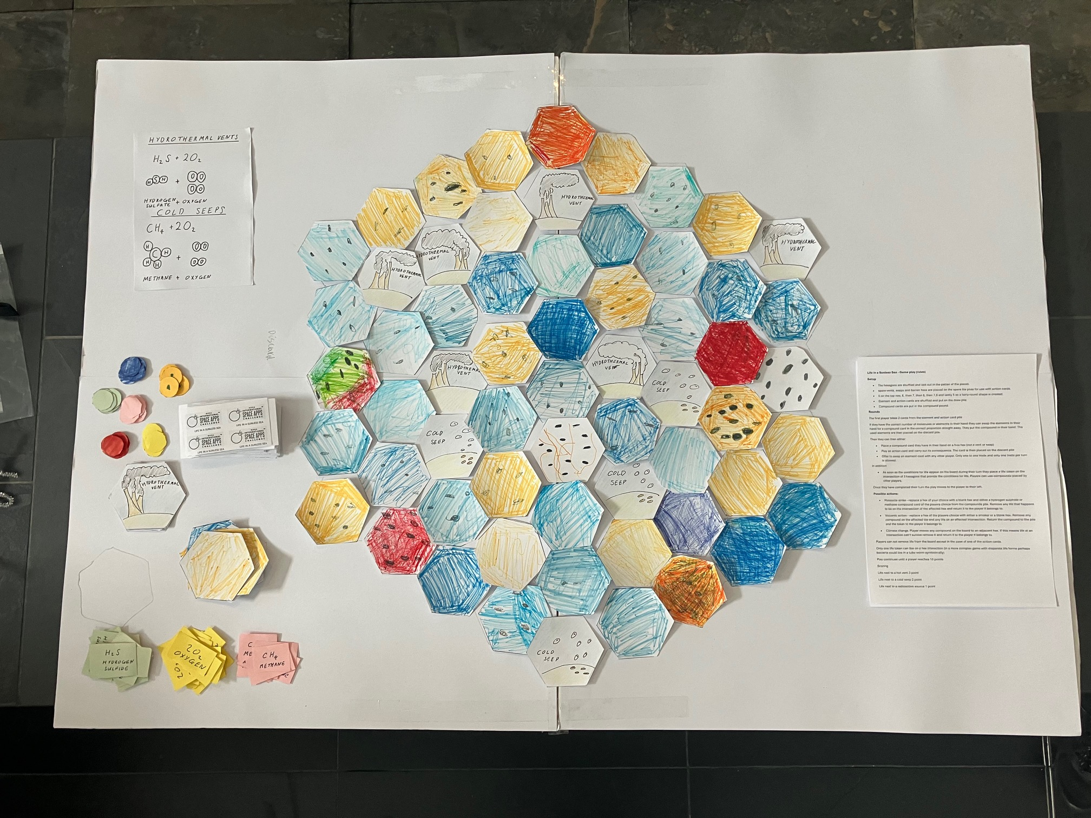
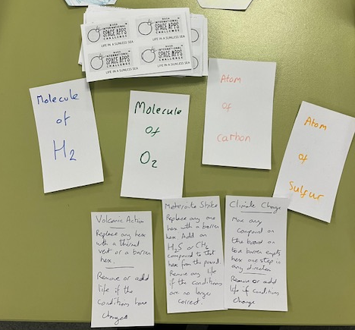
Playing elements
Element and Action Cards
The more refined game with rules

Slide 7
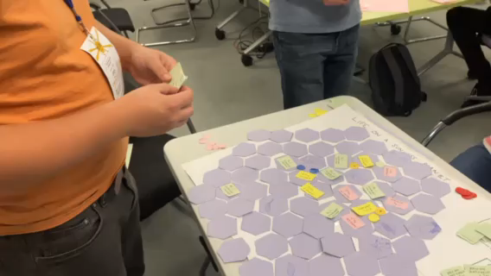
GAME PLAY (raw prototype)
How volcanic action can lead to life developing

